Slide 1
Time Series Modelling
ASREEDHAR

Slide 2

Motivation
When you have data that have time trends in them most statistical methods fail because they assume that each observation has no bearing on the next observation.
Hoping to discuss about test cases for the use of time series statistical modelling methods.
If such use cases do exist, would be good to add such modelling techniques to the existing DA statistical modelling arsenal. (Differentiator)
P.S. : Speaking of Arsenal, London will always be red, don’t let the Blues or the Spurs tell you otherwise! (SHAMELESS ARSENAL PLUG)

Slide 3
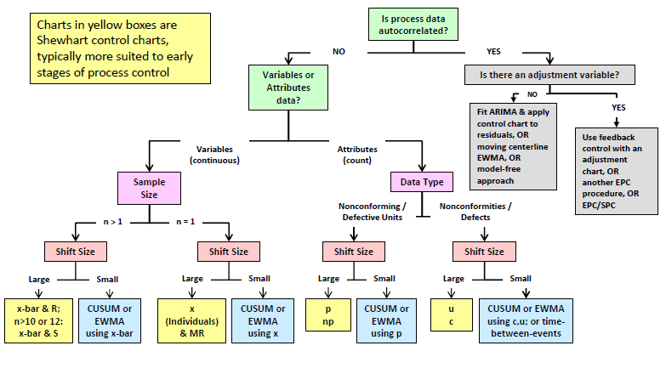
THE WHY
Each Observation row has an impact on subsequent rows

Slide 4
Basic Terminology
Stationary data: The data would not be affected by changes in time.
Strictly Stationary: The probability density function of the data does not change with change in time.
Weakly Stationary: The mean and variance of the data remain constant with time. (For the purpose of this presentation let us look at this as the end goal)
Autocorrelation: The correlation of the variable with itself. Normally given by the formula
ρ_{k}= Cov(y_{t},y_{t+k})/sqrt(Var(y_{t})Var(y_{t+k}))
Backshift Operator (B): It is used to shift the variable to its value at a previous time period. It is used a shorthand for denotation of variables at a previous time period.
y_{t-1=} By_{t}
Y_{t-k}=B^{k}y_{t}

Slide 5
THE HOW
There are quite a few methods out there that can be used for statistical modelling of a time series. Some of the popular methods that you have probably heard about are mentioned below:
Moving Average Smoothers
First Order Exponential Smoothers
Second Order Exponential Smoothers
ARIMA OR ARMAX Models ( They say you shouldn’t have favorites but lets all be honest here, we all do)

Slide 6
Moving Average Smoother
We define a window of N observations and then we average those N observations to make those predictions/model the time series.
M_{t}=(y_{t}+ y_{t-1}………… y_{t-N+1})/N
Now the drawbacks with using this as a smoothing model for the time series is that:
A smaller N will make a moving average reactive, but the output of the smoother will be way too noisy and hence might not remove the effect of time on the mean. (What we are trying to do is effectively model the mean of a time series to use the output of this to run other model building approaches.
A larger N will certainly make the data less noisy but what you will have is a lagging predictor that is not as sensitive to process changes.
Also the magnitude of effect given to each observation is the same in the window (1/N) which not be the same since nearer observations to the time period need to have a greater say in the prediction equation.

Slide 7
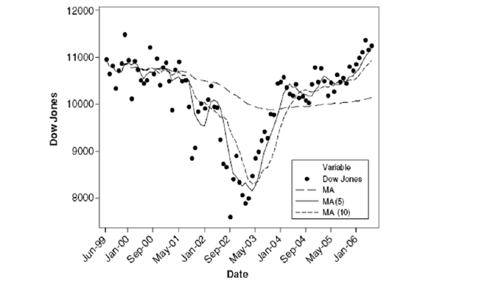

Slide 8

First Order Exponential Smoother
The Exponential smoother was created for the sole purpose of exponential weighting the past observations, so the nearest observations have a greater bearing on the forecast as compared to past observations. (P.S. Your Graph builder smoother does exactly this)
=
(where λ is any value between 0 and 1)
The drawback of this method is that when we a time-based trend for example a stock price that keeps increasing the exponential smoother cant keep up since it’s modelling for mean (Intercept) and hence there will be a lot of bias in the model and hence it won't be an unbiased estimator anymore.

Slide 9
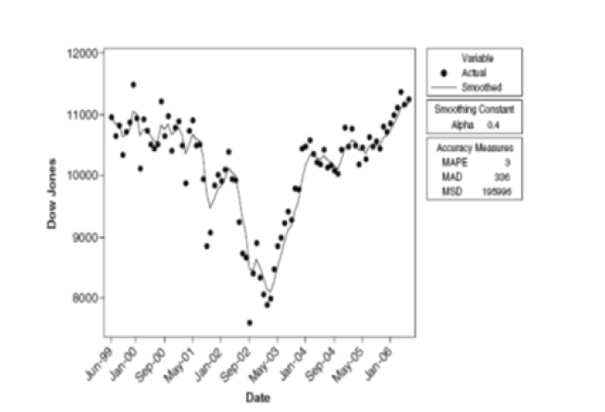
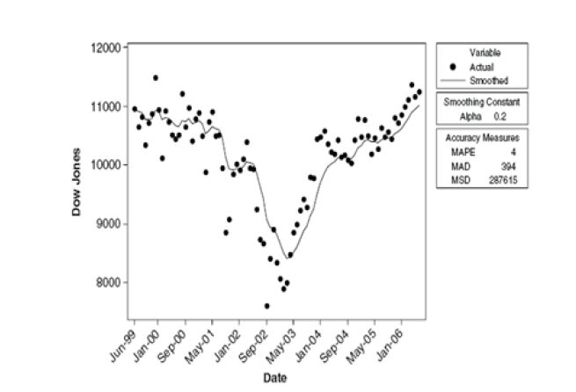

Slide 10
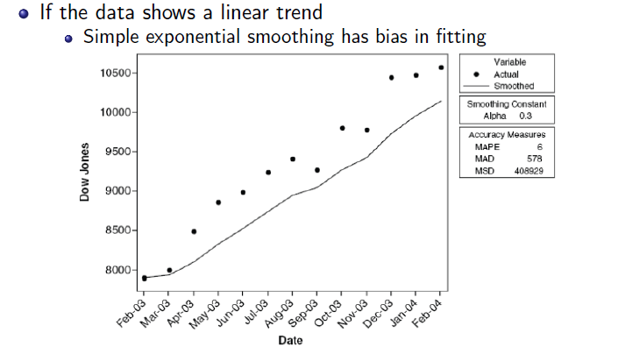

Slide 11
Second Order Exponential Smoother
This model is used when the data does show a time trend.
Second Order Exponential smoother is an unbiased estimator of the data in which you have a time-based trend.
Using this model you are able to forecast τ periods ahead from your last observed data point at time T.
The greater the τ the more inaccurate your prediction becomes you start using predictions to make future predictions. ( Recursive)

Slide 12
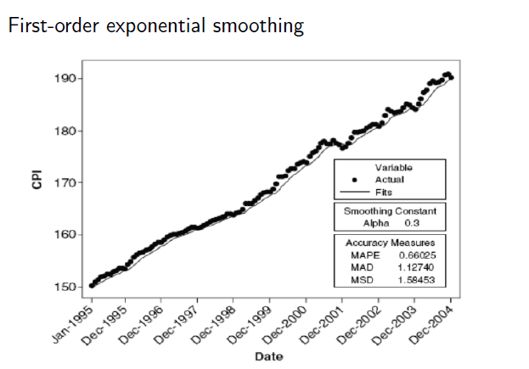
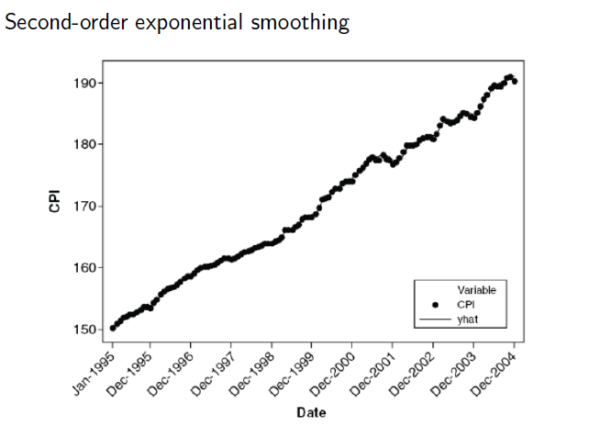
You can see the Bias is much lesser in the case of the Second Order Exponential Smoothing Model

Slide 13
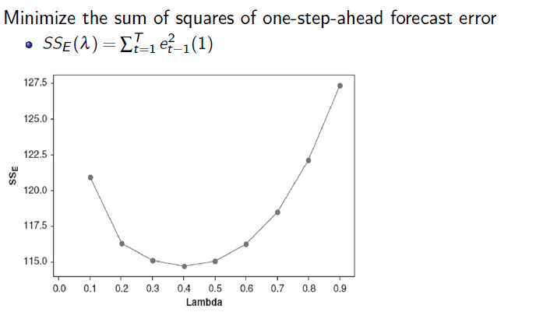
Optimal λ (Discount Factor)
This what JMP effectively does in the background to give you the optimal smoothing factor option.

Slide 14
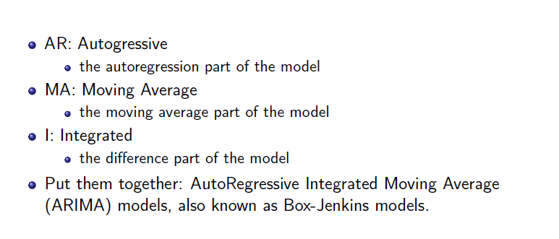
ARIMA Modelling (p,d,q) Basic Terminology
p is the order of the auto-regressive component
d is the order of the differentiating component (Used when there are trends in the data)
q is the order of the MA component in the model.

Slide 15
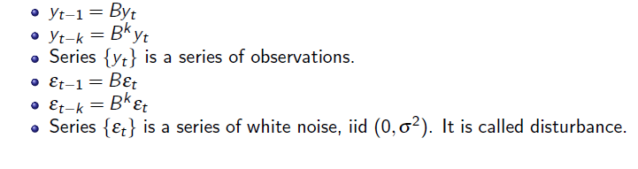
ARIMA Modelling
The aim here is to use ARIMA modelling to effectively remove any time effects on the series {y_{t}}. The residuals from this model if they resemble white noise can be mined against independent factors to get correlations that not convoluted by the auto-correlation effects.

Slide 16
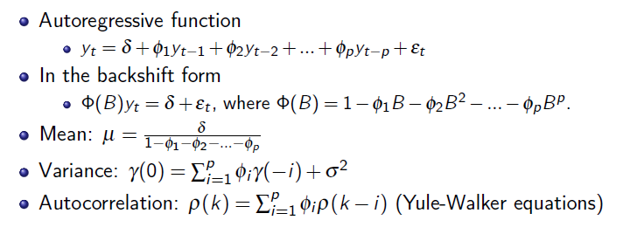
Example 1: ARIMA (p,0,0)
We only have auto-regressive components in this ARIMA model.
Φ_{i} they are coefficients for the auto-regressive components.
Yule-Walker equations are normally what JMP uses in the background when it tries to find those coefficients.
is the formula to calculate the variance at the time lag of 0.

Slide 17
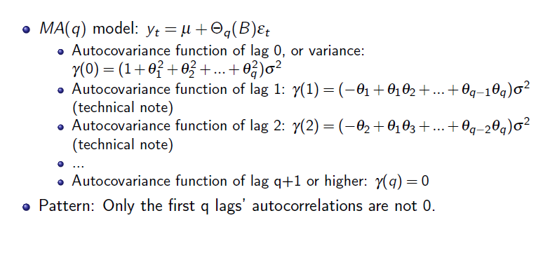
Example 2: ARIMA (0,0,q)
After the first q lags are visible in the ACF plot. Helpful in the model identification process. (More on this in the model Identification Part)

Slide 18
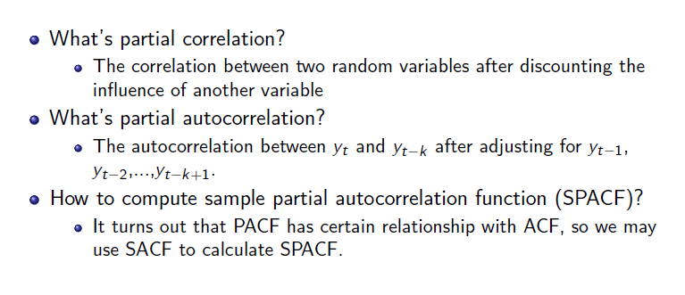
Partial Autocorrelation (PACF)

Slide 19
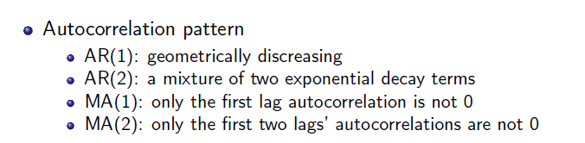
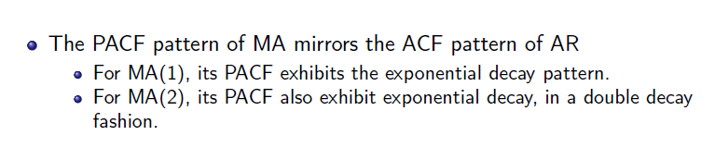
Model Identification
If both AR and MA components are present in the model. It is difficult to identify the order of the ARIMA model and you use a permutation-based approach where you try a bunch of different models are check the model performance characteristics.

Slide 20
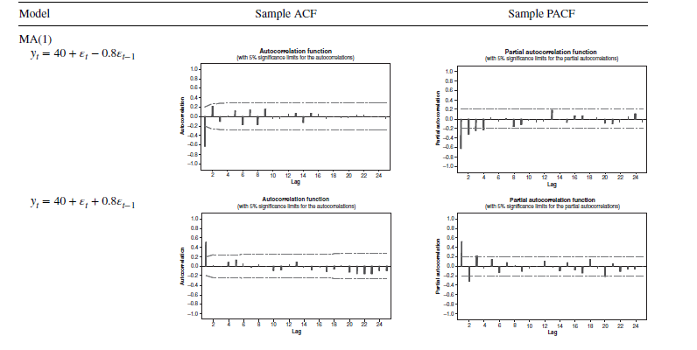

Slide 21
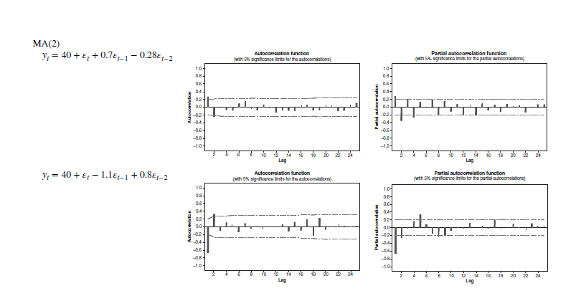

Slide 22
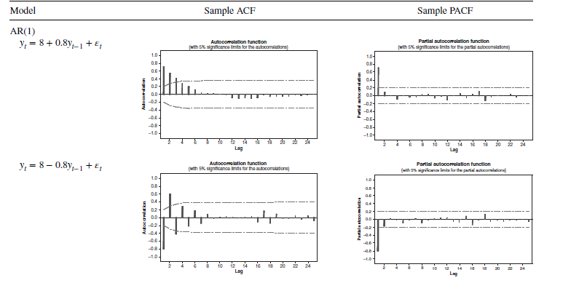

Slide 23
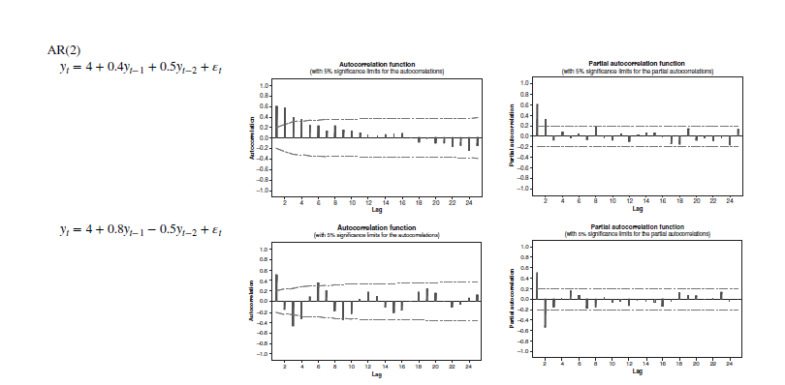

Slide 24
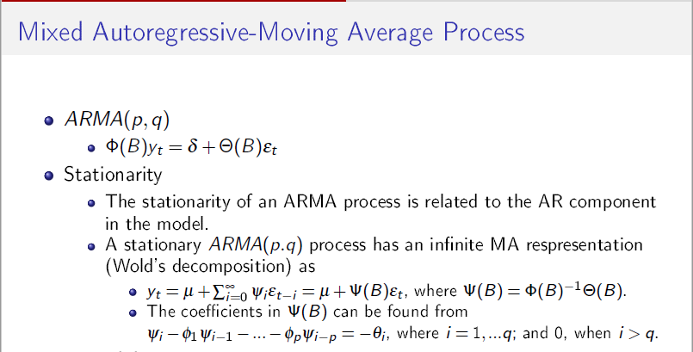

Slide 25
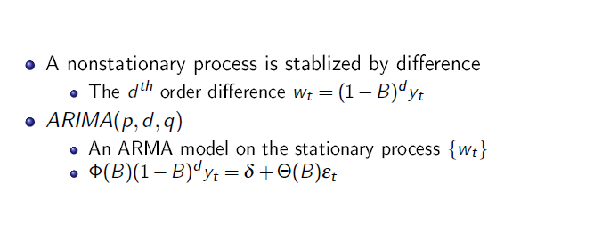
Non-Stationary Data (Trend): Differentiation
This is where the d component of the ARIMA model comes in.

Slide 26
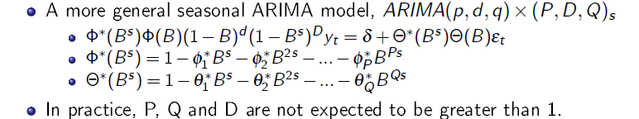
Seasonal ARIMA Models (p,d,q)x(P,D,Q)_{s}
p is the order of the non-seasonal AR component
q is the order of the non-seasonal MA component
d is order of non-seasonal differencing
P order of seasonal AR component
Q order of seasonal MA component
D order of seasonal differencing
s number of observations in a period. (Ex. Monthly data s=12)
Normally you use seasonal difference to remove seasonal components, if any remain seasonal AR and MA modelling techniques are then used.

Slide 27
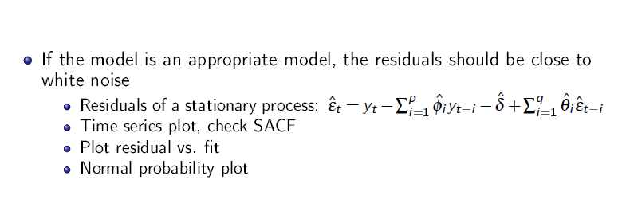
Model Validation: Residual Analysis
The idea behind this is that if the model is appropriate, the residuals from this fit model should be effectively white noise. (Random, No AC Patterns)
For Model Performance check:
Check statistics: MAD, MAPE of forecasts
Check Information Criterion: AIC, BIC (Lower is better)

